Slide 1
Social Network Ads
Sai Sri Narne

Slide 2
Project Goal
This dataset is obtained by Kaggle
It contains the data about profiles of the users on the social network who on interacting with the advertisement either purchased the product or not
Goal is classify the customers based on their age, estimated salary and whether they made a purchase or not
Supervised or Unsupervised?
Classification or Regression?
Prediction or Inference?

Slide 3
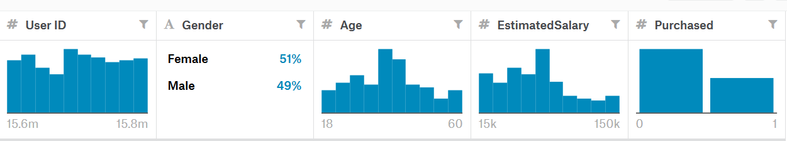
Data Set
Data Columns | Type
User ID | Quantitative
Gender | Qualitative
Age | Quantitative
Estimated Salary | Quantitative
Purchased | Quantitative (0-Not Purchased 1- Purchased)
Training Data- 300 Observation
Testing Data- 100 Observation
Predictors or Features considered-
Age
Estimated Salary
Response or Prediction-
Purchased

Slide 4
Approaches
Logistic Regression
Classification Trees
Support Vector Machines
Random Forest
Naïve Bayes

Slide 5
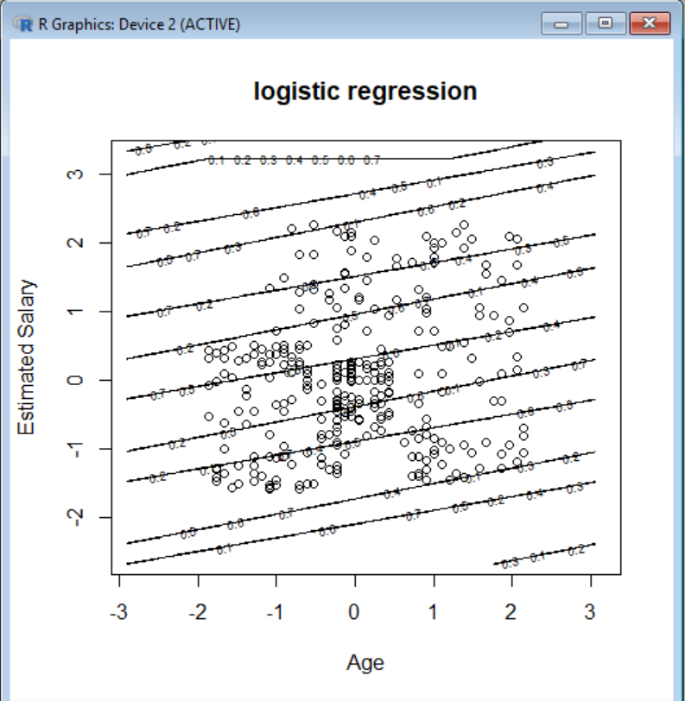
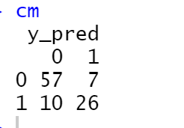
Logistic Regression
Confusion Matrix
Accuracy- 0.83

Slide 6
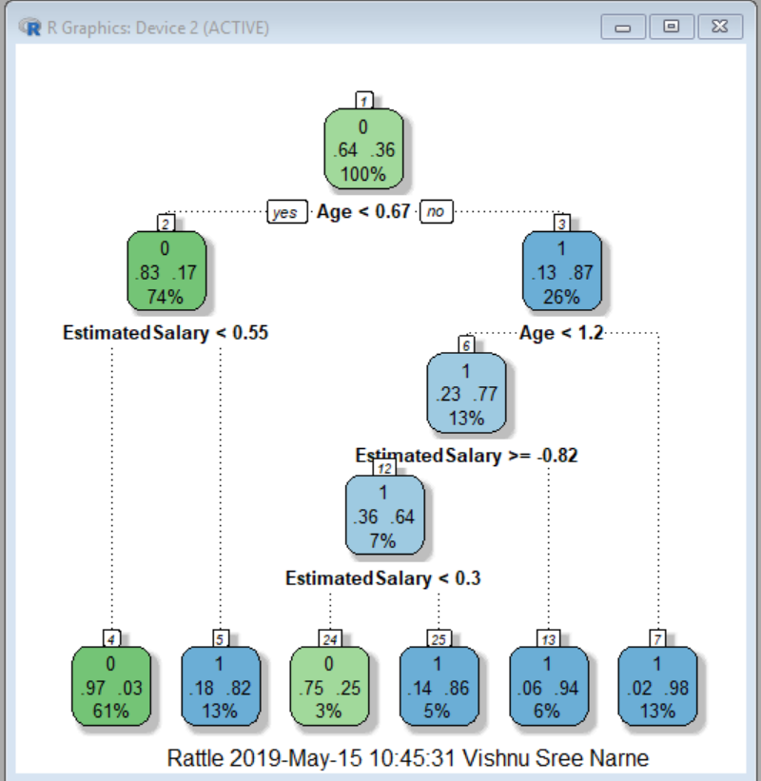
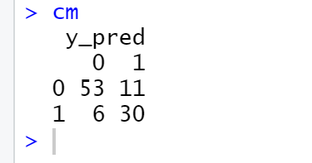
Classification Decision Trees
Confusion Matrix
Accuracy- 0.83
Used rpart function to construct tree
Visualized FanancyRpartPlot
Tried changing weights accuracy was bad

Slide 7
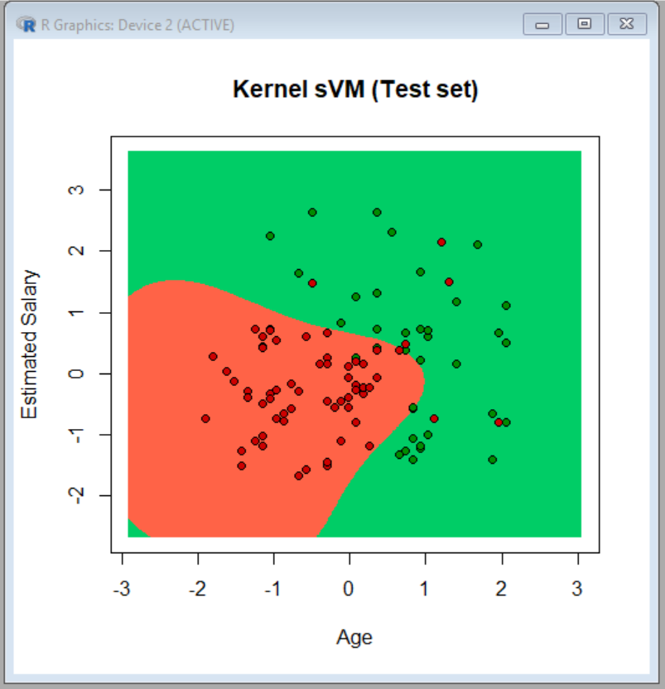
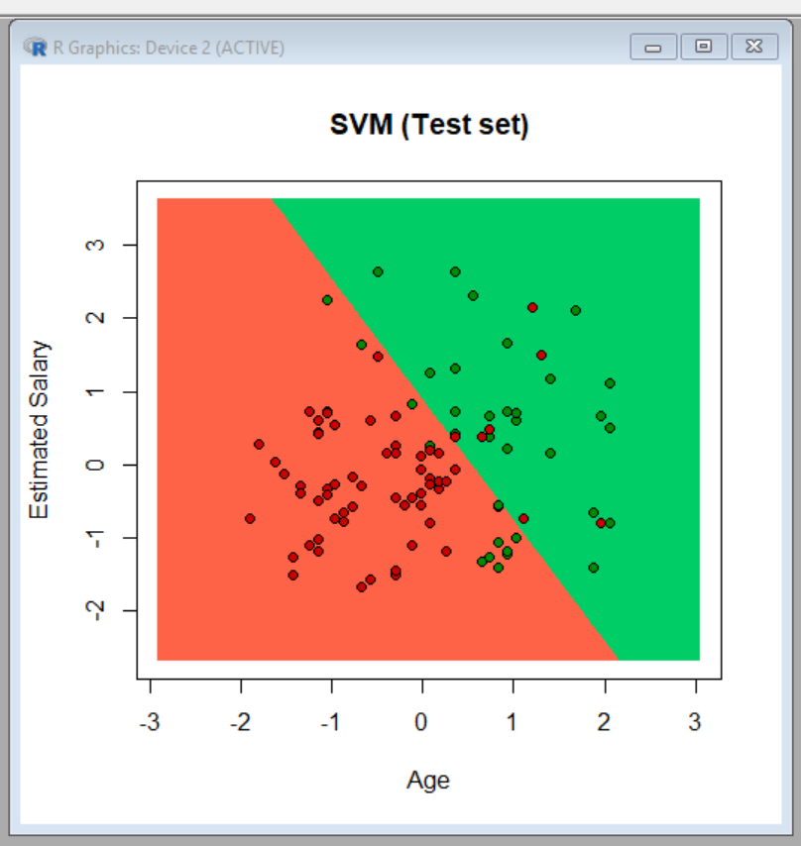
Kernel Support Vector Machine

Slide 8
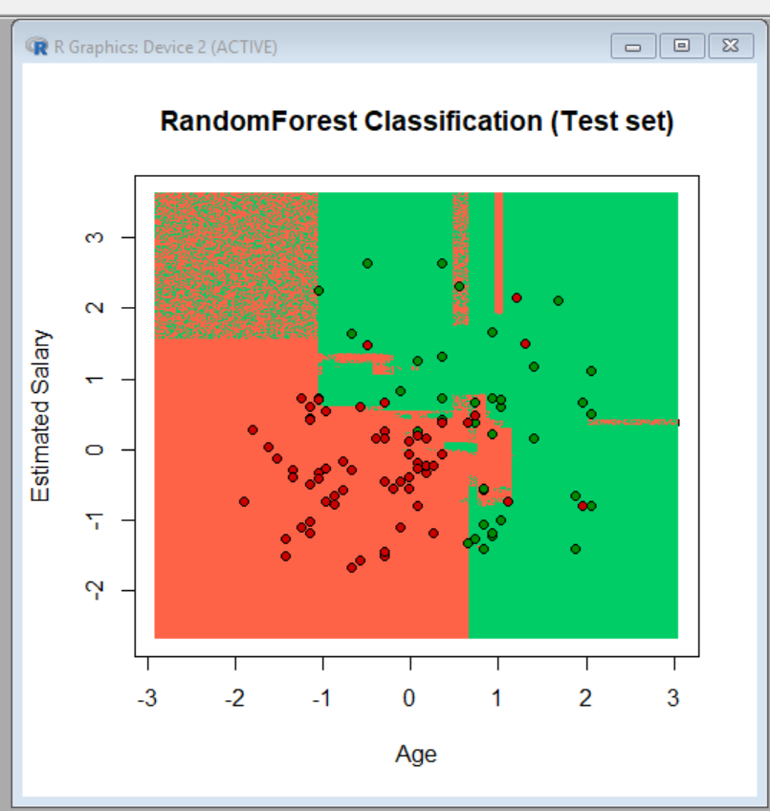
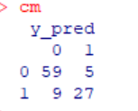
Random Forest
Accuracy 86

Slide 9

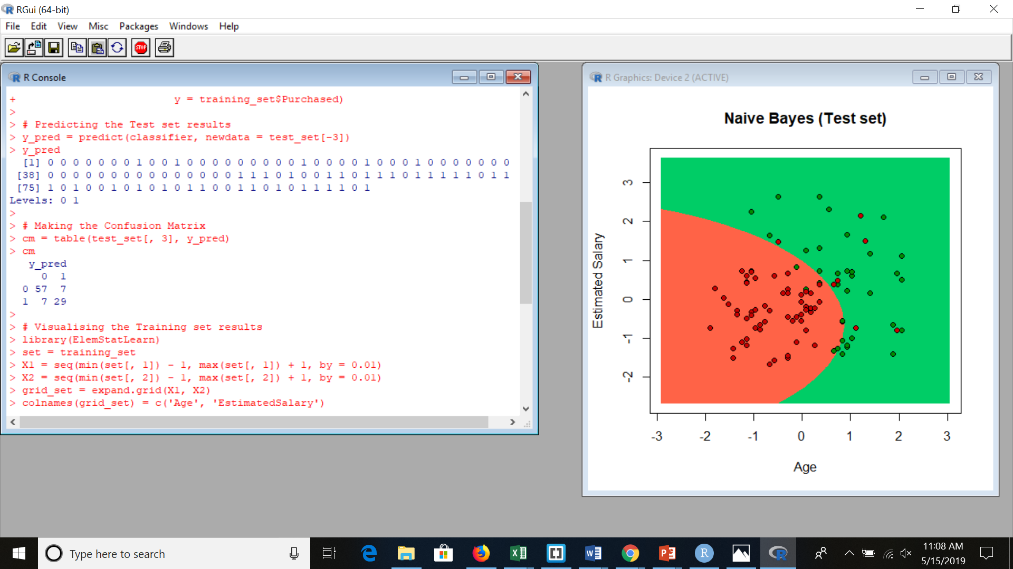
Naive Bayes
It implements the Gaussian Naive Bayes algorithm for classification. The likelihood of the features is assumed to be Gaussian:
Accuracy -86
Confusion Matrix
Predictions

Slide 10
References
https://www.kaggle.com/sash1563/social-network-ads
https://www.rdocumentation.org/packages/
https://github.com/SaiSriNarne/ISL_Social_Networking_Ads

Slide 11
Thanks

